Slide 1
Module 2 Syntax Analysis

Slide 2
Syllabus:
Introduction
Context Free Grammars
Writing a Grammar
Top-down Parsers
Bottom-up Parsers

Slide 3
The Role of the Parser:
Definition: Parsing is the process of getting tokens from the lexical analyser and obtains a derivation for the sequence of tokens and builds a parse tree.
Thus, if the program is synthetically correct, the parse tree is generated.
If a derivation for the sequence of tokens does not exist, i.e., if the program is synthetically wrong, it results in syntax error and the parser displays the appropriate error messages.
The parse tree is also called as syntax tree.
Parser also called syntax analyser this is the one which does parsing.

Slide 4
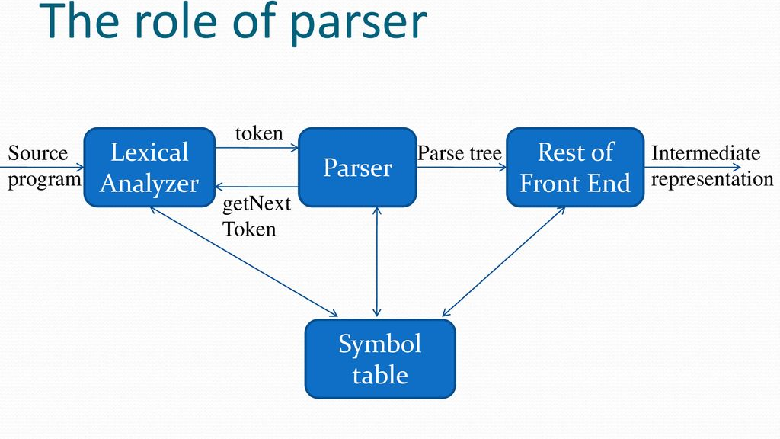

Slide 5
There are 3 general types of parsers for grammars:
Universal,
Top-down, and
Bottom-up.
Universal parsing methods such as the Cocke-Younger-Kasami algorithm and Earley’s algorithm can pass any grammar. These methods are inefficient.
The methods commonly used in compilers can be classified as being either top-down or bottom-up.
Top-down method builds parse trees from the top(root) to the bottom(leaves), while bottom-up method start from the leaves and work their way up to the root.
In either case, the input to the parser is scanned from left to right, one symbol at a time.

Slide 6
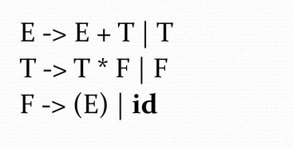
Representative Grammar:
Constructs that begin with keywords like while or int, are relatively easy to parse, because the keyword guides the choice of the grammar production that must be applied to match the input.
Associativity and precedence are captured in the following grammar:
‘E’ represents ‘expressions’ consisting of ‘terms’ separated by ‘+’ signs, ‘T’ represents ‘terms’ consisting of ‘factors’ separated by ‘*’ signs, and ‘F’ represents ‘factors’ that can be either ‘parenthesized expressions’ or ‘identifiers’.

Slide 7
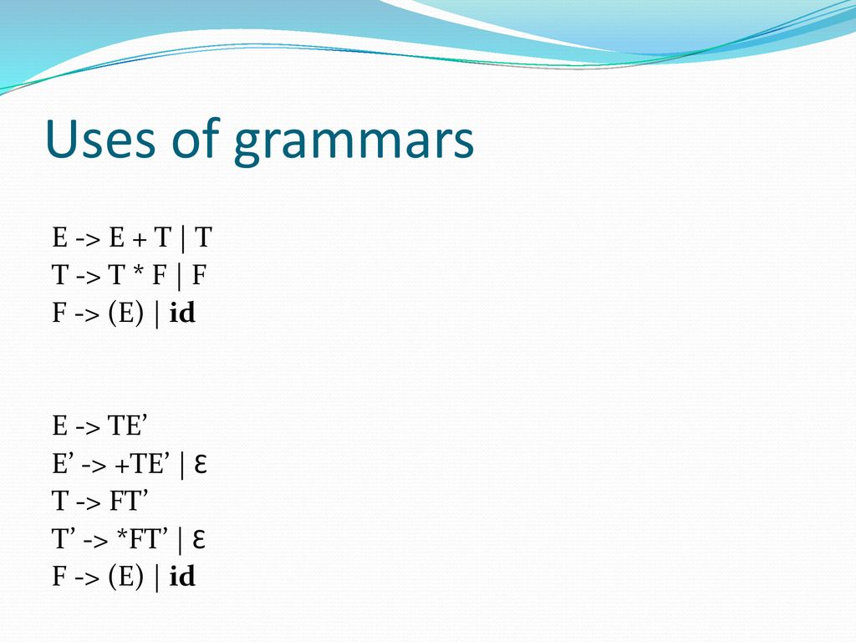

Slide 8
Syntax Error Handling:
Common programming errors:
Lexical errors – misspellings of identifiers
Synthetic errors – misplaced of semicolons or braces
Semantic errors – type mismatches between operators and operands
Logical errors – anything from incorrect reasoning on the part of program.
Error handler goals:
Report the presence of errors clearly and accurately.
Recover from each error quickly enough to detect subsequent errors.
Add minimal overhead to the processing of correct programs.

Slide 9
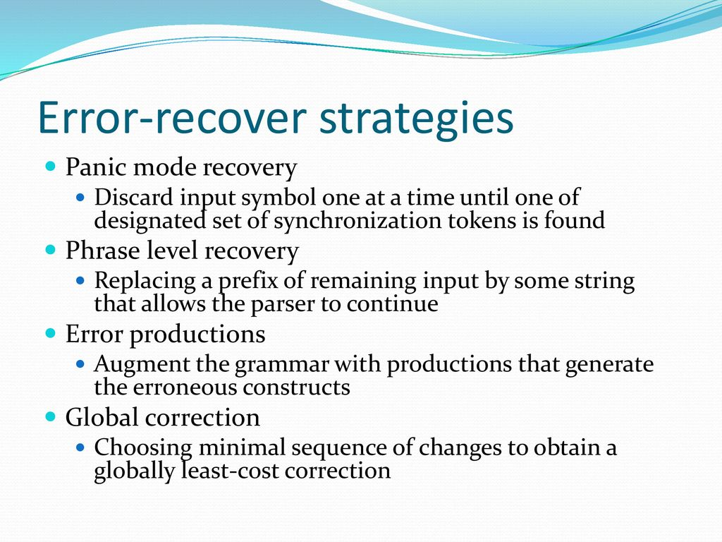

Slide 10
Context Free Grammars:
Definition: The context free grammar in short a CFG is 4 tuple,
G=(V, T, P, S) where,
V – is set of variables. The variables are also called non-terminals.
T – is set of terminals.
P – is set of productions. All productions in P are of the form A -> α where A is a non-terminal and α is string of grammar symbols.
S – is the start symbol.
E.g.: stmt -> if (expr) stmt else stmt

Slide 11
Terminals: are the basic symbols from which strings are formed. The term “token name” is a synonym for ‘terminal’ and frequently we will use the word token for terminal when it is clear that we are talking about just token name.
E.g.: the terminals are keywords ‘if’ and ‘else’ and symbols ‘(‘ and ‘)’.
Non-terminals: are synthetic variables that denote sets of strings. The set of strings denoted by non terminals helps to define the language generated by the grammar. Non terminals impose a hierarchical structure on the language that is key to syntax analysis and translation.
E.g.: ‘stmt’ and ‘expr’ are non-terminals

Slide 12
Start Symbol: In a grammar, one non terminal is distinguished as the start symbol, and the set of strings it denotes is the language generated by the grammar.
Production: of a grammar specify the manner in which the terminals and non terminals can be combined to form strings. Each production consists of:
A non terminal called the head or left side of the production; this production defines some of the strings denoted by the head.
The symbol -> sometimes ::= has been used in place of arrow.
A body or right side consisting of zero or more terminals and non terminals. The components of the body describe one way in which strings of the non terminal at the head can be constructed.

Slide 13
Notational Conventions:
These symbols are terminals:
Lowercase letters early in the alphabet, such as a, b, c, d, etc.
Operator symbols such as +, *,-, /, and so on.
Punctuation symbols such as parentheses, comma, and so on.
The digits 0, 1. . . 9.
Boldface strings such as ‘id’ or ‘if’, each of which represents a single terminal symbol.

Slide 14
2. These symbols are non terminals:
Uppercase letters in the alphabet, such as A, B, C.
The letter S, which, when it appears, is usually the start symbol.
Lowercase, italic names such as expr or stmt.
When discussing programming constructs, uppercase letters may be used to represent Non terminals for the constructs. For example, non terminal for expressions, terms, and factors are often represented by E, T, and F, respectively.
Uppercase letters in the alphabet, such as, X, Y, Z, represent grammar symbols; i.e., either non-terminals of terminals.
Lowercase letters in the alphabet, u, v, …., z, represents (possibly empty) strings of terminals

Slide 15
Lowercase Greek letters, α, β, γ, for example, represent strings of grammar symbols. Thus, a generic production can be written as, A -> α, where A is the head and α is the body.
A set of productions, A -> α1, A -> α2, … A -> αk with a common head A, may be written as A -> α1| α2|…| αk.
Unless stated otherwise, the head of the first production is the start symbol.

Slide 16
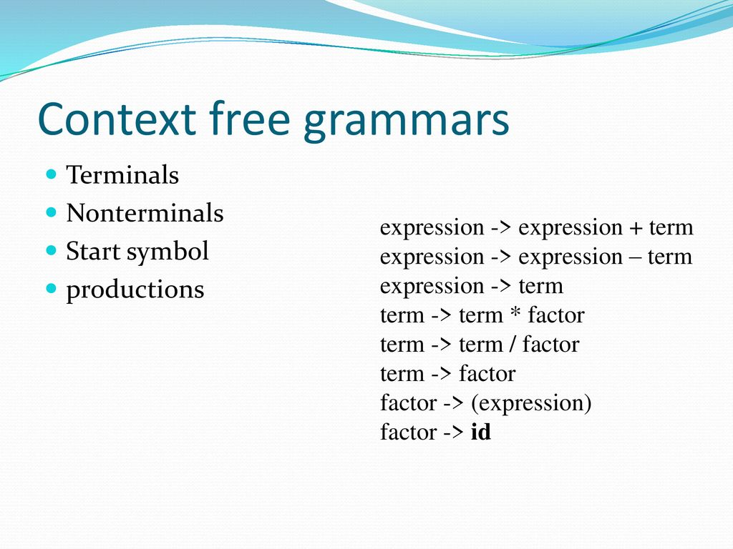

Slide 17
Derivations:
Definition: The process of obtaining string of terminals and/or non-terminals from the start symbol by applying some set of production (or all productions) is called derivation.
E.g.: if A -> αBγ and B -> β are the productions, the string αβγ can be obtained from A-production as shown,
A => αBγ
A => αβγ
the above derivation can also be written as:
A => αβγ
+

Slide 18
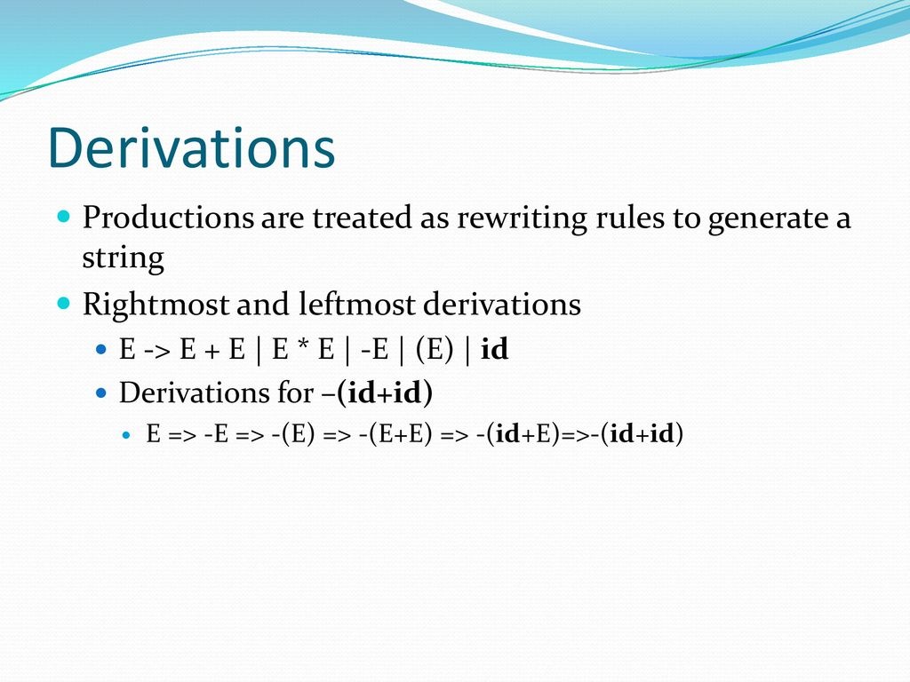

Slide 19
The two types of derivations are:
Leftmost derivation (LMD):
The process of obtaining a string of terminals from the sequence of replacements such that only leftmost non-terminal is replaced at each and every step is called leftmost derivation.
Rightmost Derivation (RMD):
The process of obtaining a string of terminals from the sequence of replacements such that only rightmost non-terminal is replaced at each and every step is called rightmost derivation.
Example: E -> E+E| E*E| (E) | id
Obtain string: id+id*id

Slide 20
Sentential Form of G (Sentence of G):
*
If S => α, where S is the start symbol of the grammar G, we say that α is a sentential form of G.
The sentential form may contain both terminals and non-terminals and may be empty.
A sentence of G is a sentential form with no non-terminals.
The language generated by a grammar is its set of sentences. Thus, a string of terminals w is in L(G), the language generated by G, if and only if w is a sentences of G (or S => w).
A language that can be generated by a grammar is context-free grammar.
*

Slide 21
Type of Sentential Form:
Left Sentential Form:
If there is a derivation of the form S=>α , where at each step in the derivation process only a leftmost variable is replaced, then α is called left-sentential form of G.
Right Sentential Form:
If there is a derivation of the form S=>α , where at each step in the derivation process only a rightmost variable is replaced, then α is called right-sentential form of G.
Example: E -> E+E| E*E| (E) | id
Derive the leftmost derivation for the above grammar.
{The string of grammar symbols obtained in each step of leftmost derivation are the various left-sentential form of G.}
*
*

Slide 22
Parse Trees and Derivations:
A parse tree is a graphical representation of a derivation that filters out the order in which productions are applied to replace non-terminals.
Each interior node of a parse tree represents the application of the production.
The interior node is labeled with a non-terminal ‘A’ in the head of the production; the children of the node are labeled from left tor right, by the symbols in the body of the production by which this ‘A’ was replaced during the derivation.
Example: Construct a parse tree for the given grammar: E -> E+E| E*E| (E) | id
The leaves of the parse tree are labelled by non terminals or terminals, and read from left to right, constitute a sentential form, called the yield or frontier of the tree.
Read from left to right: id+id*id, this is the yield of the given parse tree.

Slide 23
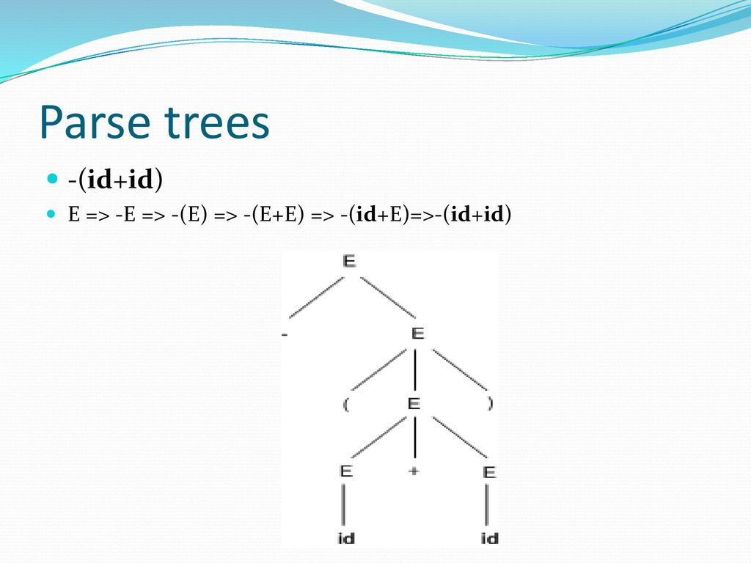

Slide 24
Ambiguity:
A grammar that produces more than one parse tree for some sentence is said to be ambiguous.
An ambiguous grammar is the one that produces more than one leftmost derivation or more than one right most derivation for the same sentence.
Example: the arithmetic expression grammar below permits 2 distinct leftmost derivation for this sentence: id+id*id.
Grammar: E -> E+E| E*E| (E) | id
Since the 2 parse trees are different for the same sentence id+id*id by applying leftmost derivation, the grammar is ambiguous.
It is convenient to use carefully chosen ambiguous grammars, together with disambiguating rules that ‘throw away’ undesirable parse trees, leaving only one tree for each sentence

Slide 25
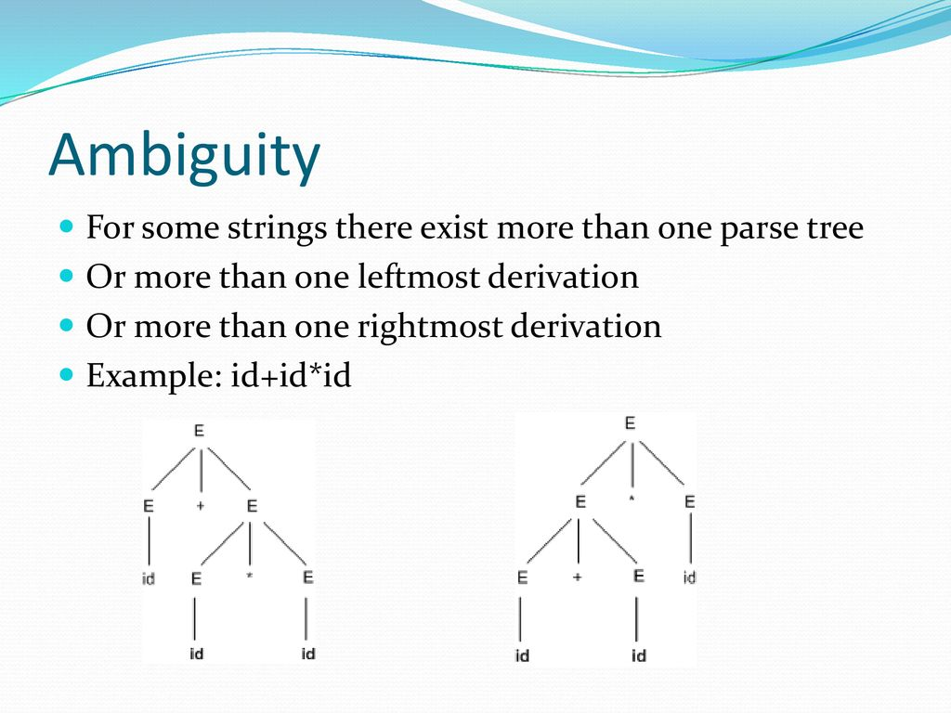

Slide 26
Writing a Grammar:
Grammars are capable of describing most, but not all, of the syntax of programming languages.
For instance, the requirement that identifies be declared before they are used, cannot be described by a context free grammar.
Therefore, the sequences of tokens accepted by a parser form a superset of the programming language; subsequent faces of the company must analyse the output of the parser to ensure compliance with rules that are not checked by the parser.

Slide 27
Lexical vs. Syntactic Analysis:
To use regular expressions to define the lexical syntax of a language, there are several reasons.
Separating the syntactic structure of a language into lexical and non lexical paths provides a convenient way of modularization the front end of a compiler into 2 manageable sized components.
The lexical rules of a language are frequently quite simple, hi to describe them we do not need a notation as powerful as grammars.
Regular expressions generally provide a more concise hand easier to understand for tokens than grammars.
More efficient lexical analysers can be constructed automatically from regular expression than from arbitrary grammar.

Slide 28
Regular expressions are most useful for describing the structure of constructs such as identifiers, constants, keywords, and white space.
Grammars are most useful for describing nested structures such as balanced parenthesis, matching begin-end’s, corresponding if-then-else’s, and so on.
These nested structures cannot be described by regular expressions.

Slide 29
Eliminating Ambiguity:
Sometimes an ambiguous grammar can be rewritten to eliminate the ambiguity.
Example: eliminate the ambiguity from the following ‘dangling-else’ grammar:
stmt -> if ‘expr’ then ‘stmt’
| If ‘expr’ then ‘stmt’ else ‘stmt’
| other
Here, other stands for any other statement.

Slide 30
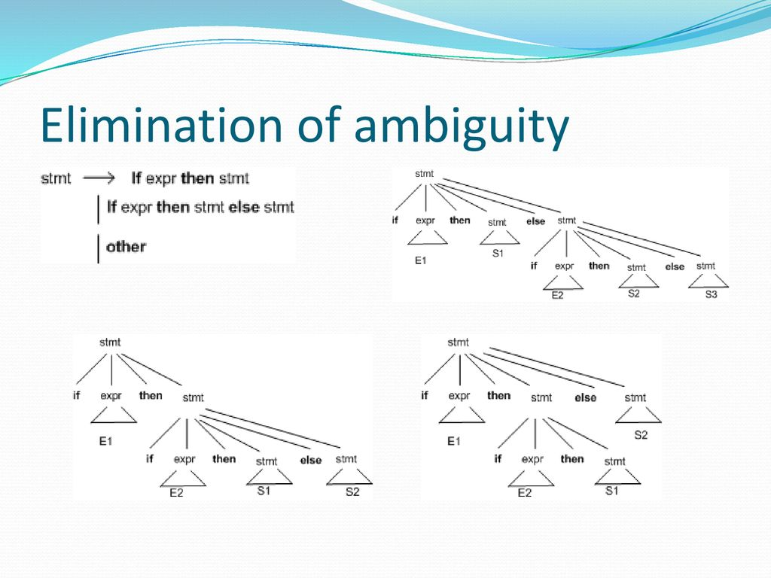

Slide 31
According to the grammar, the compound conditional statement as the parse tree:
if E1 then S1 else if E2 then S2 else S3
The grammar is ambiguous since the string below has 2 parse trees:
if E1 then if E2 then S1 else S2
In all programming languages with conditional statements of this form, the first parse tree is preferred.
The general rule is, ‘Match each else with the closest unmatched then’. This disambiguating rule can theoretically be incorporated directly into a grammar, but in practice it is rarely built into the productions.

Slide 32
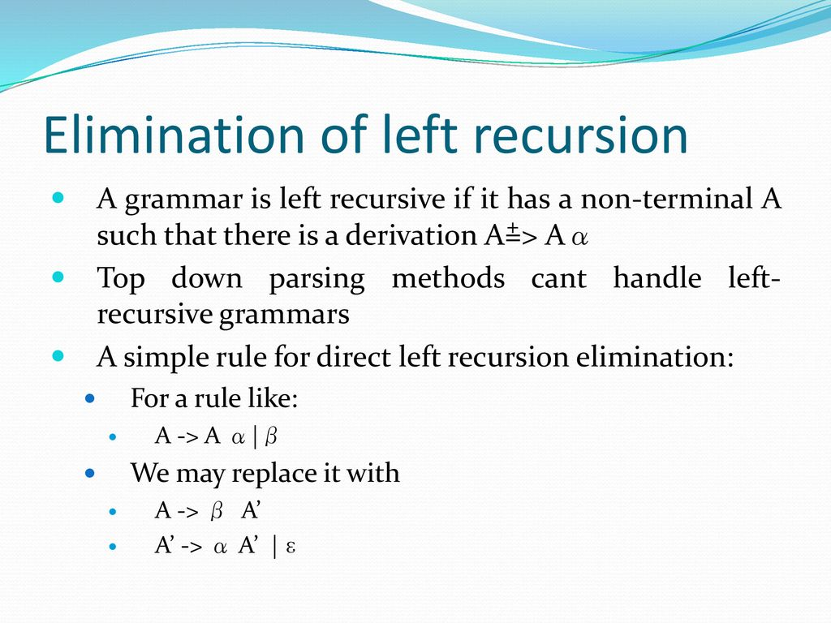

Slide 33
Example: consider the expression grammar:
The non-left recursive expression grammar:
is obtained by eliminating immediate left recursion from the expression grammar.
The left recursive pair of productions E -> E+T|T are replaced by E->TE` and
E`-> +TE`|€

Slide 34
Immediate left recursion can be eliminated by the following technique, which works for any number of A-productions.
First, group the productions as:
A-> Aα1 | Aα2 | Aα3|…..|Aαm|β1 | β2 | β3|….| βm
where no βi begins with an A.
Then, replace the A-production by,
A -> β1A`| β2A1|…..| βnA`
A`-> α1A`| α2A`|…..| αmA`|€
The non-terminal A generates the C strings as before but is no longer left recursive.
This procedure eliminates all left recursion from theA and A` productions, but it does not eliminate left recursion involving derivations of 2 or more steps.

Slide 35
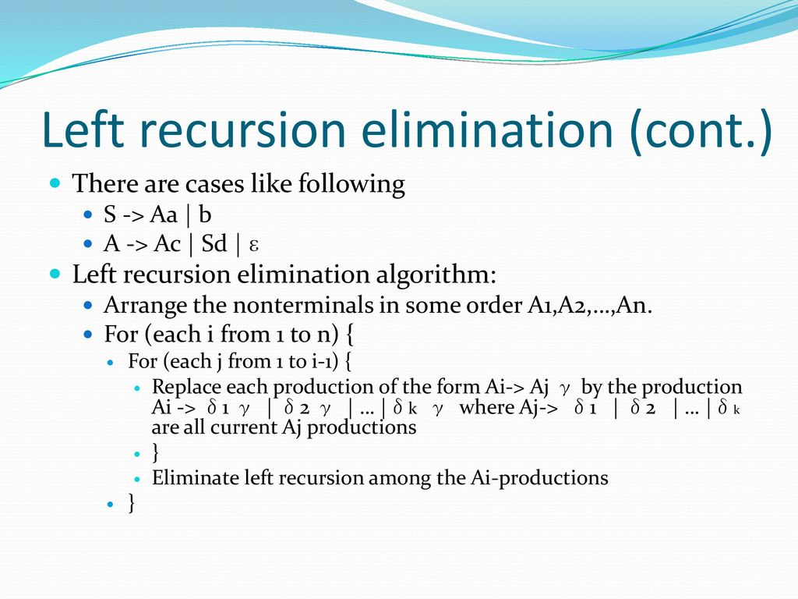

Slide 36
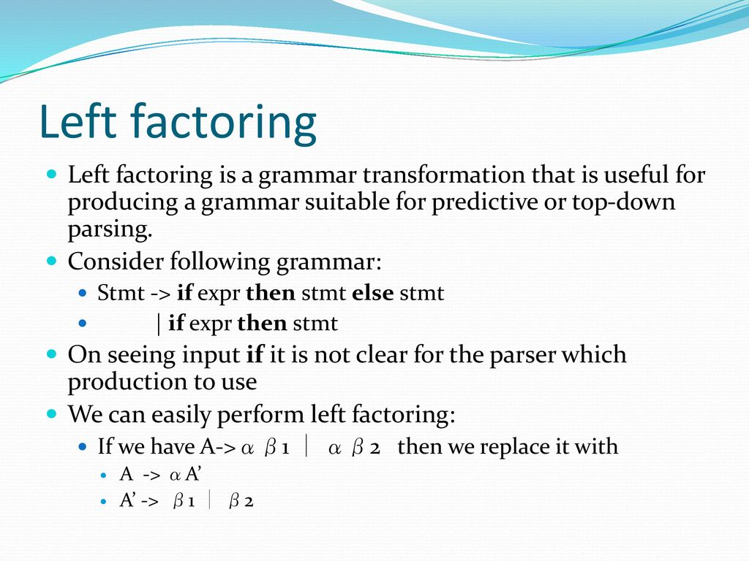

Slide 37
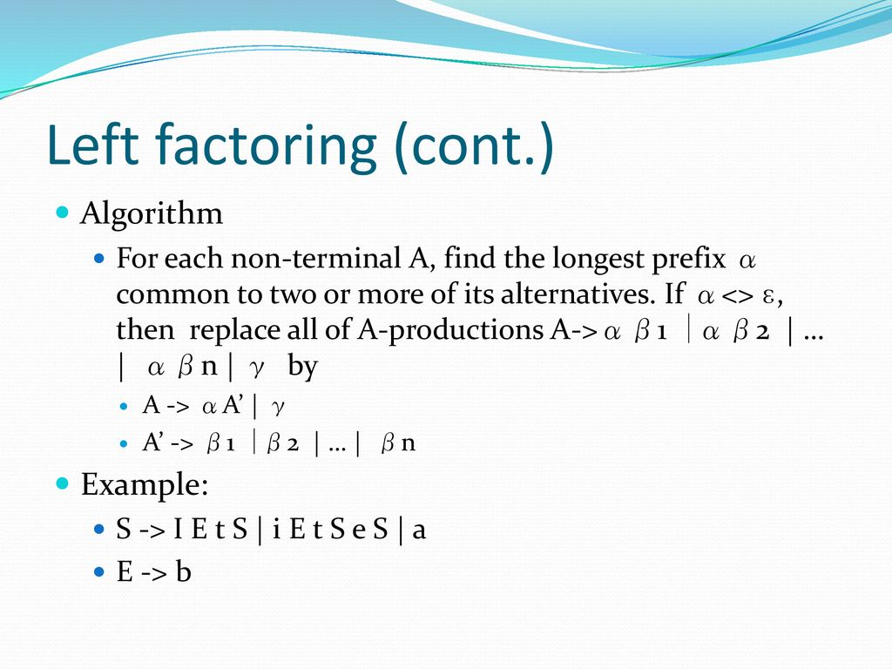

Slide 38
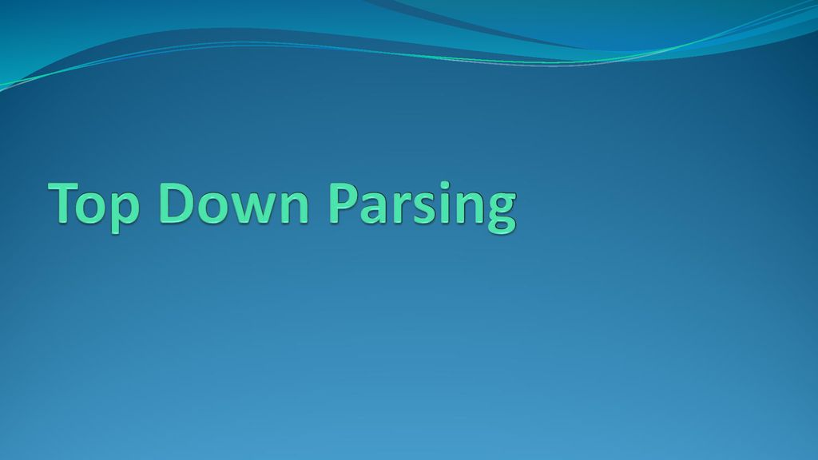

Slide 39
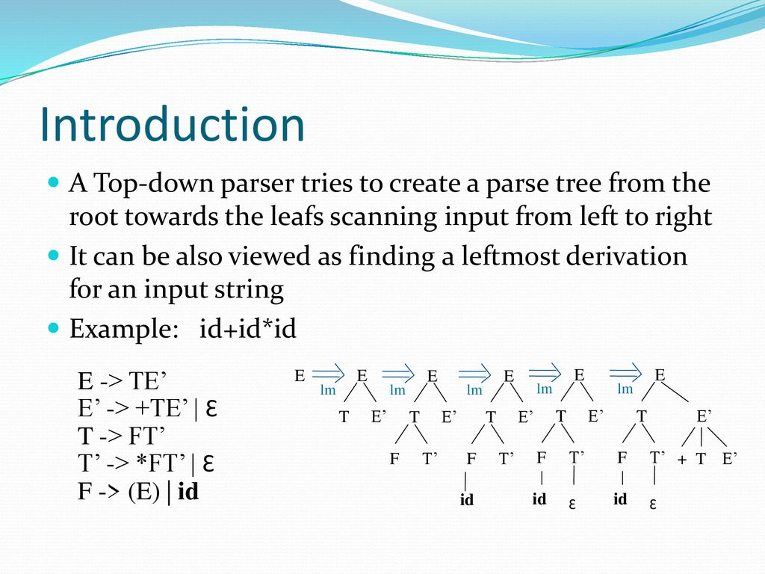

Slide 40
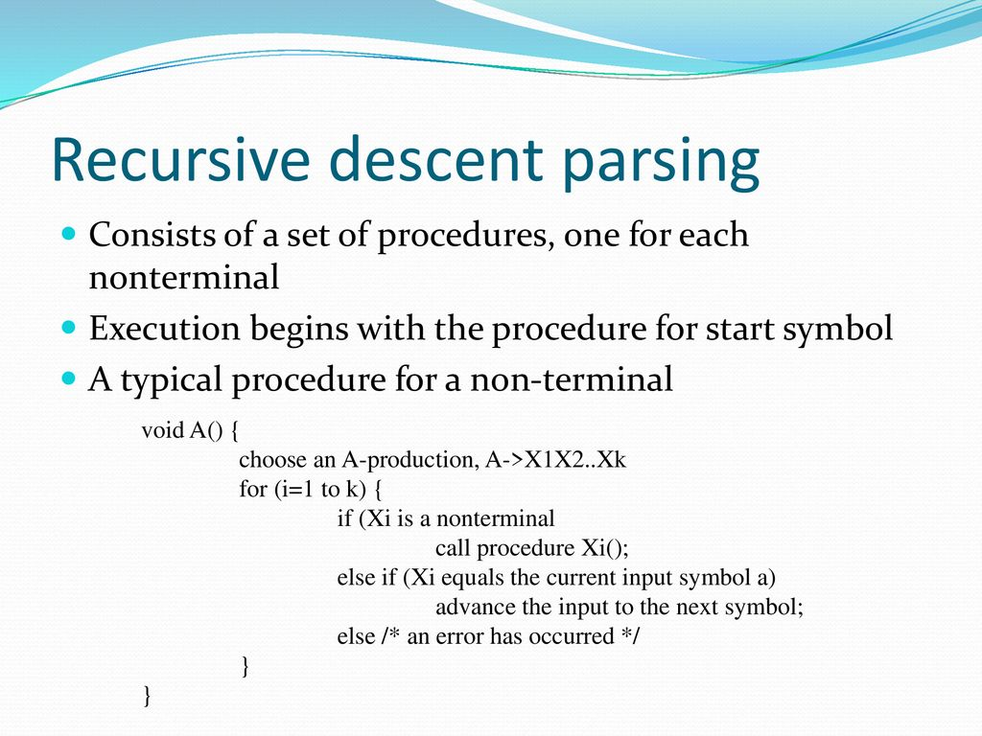

Slide 41
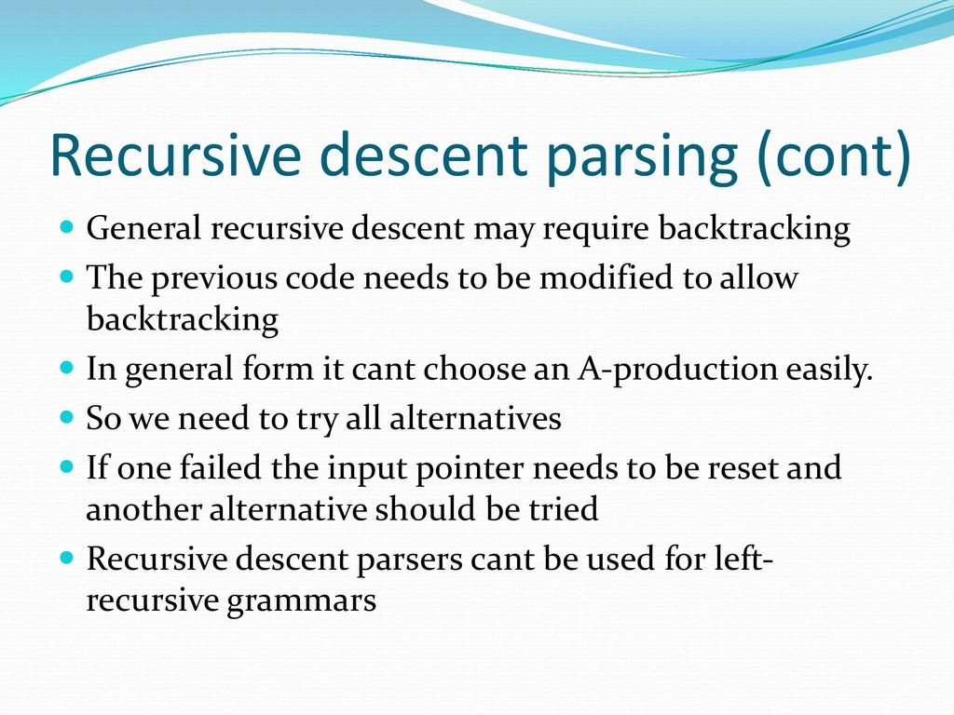

Slide 42
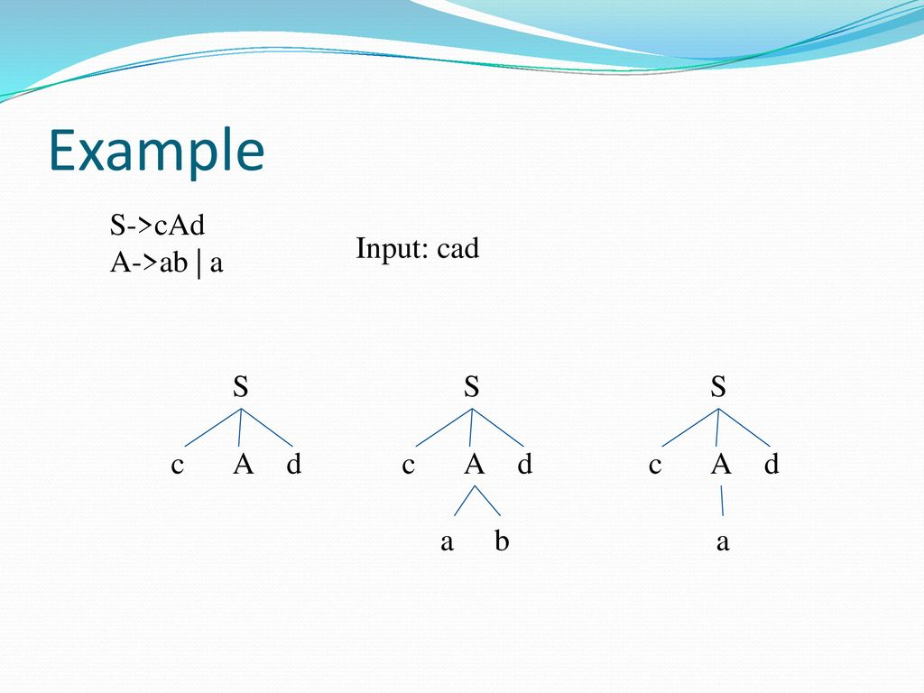

Slide 43
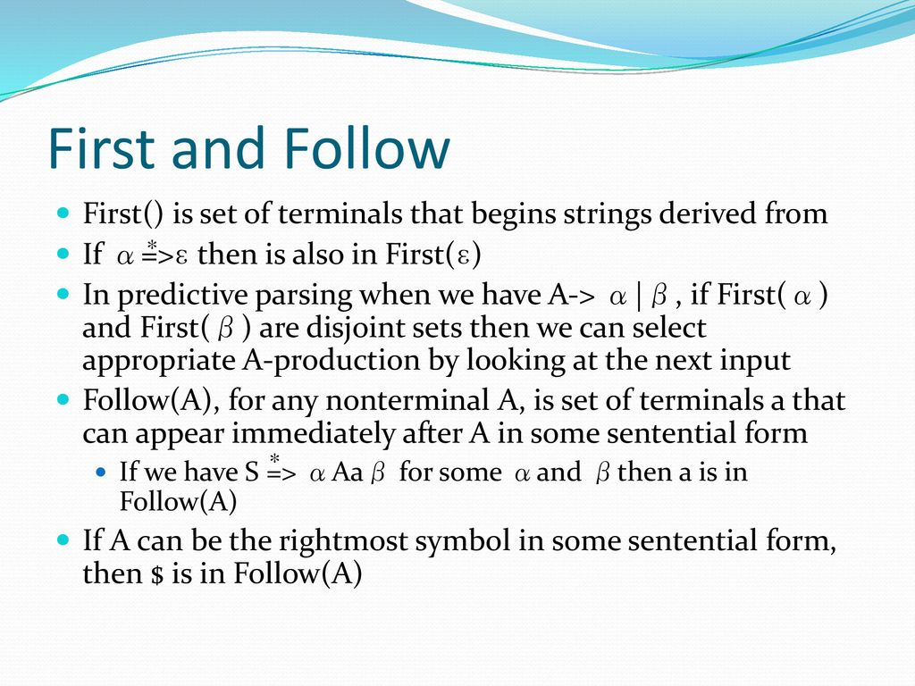

Slide 44
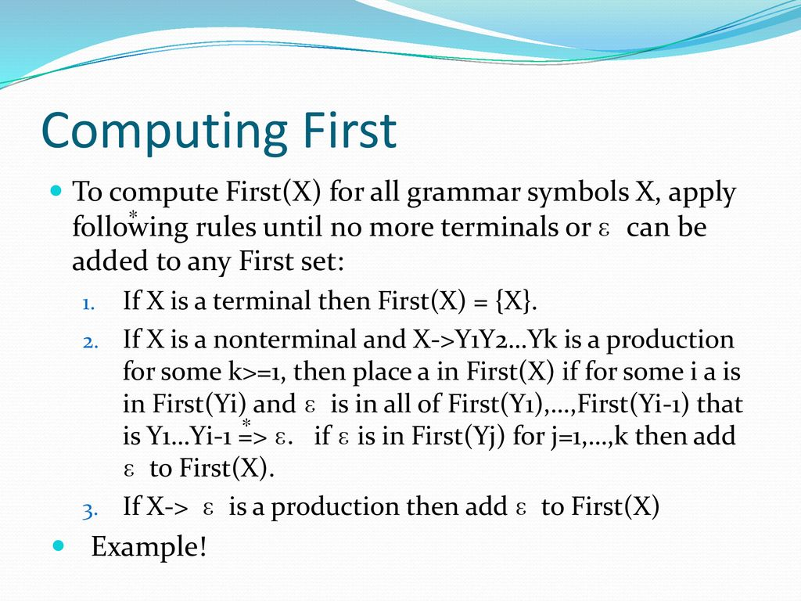

Slide 45
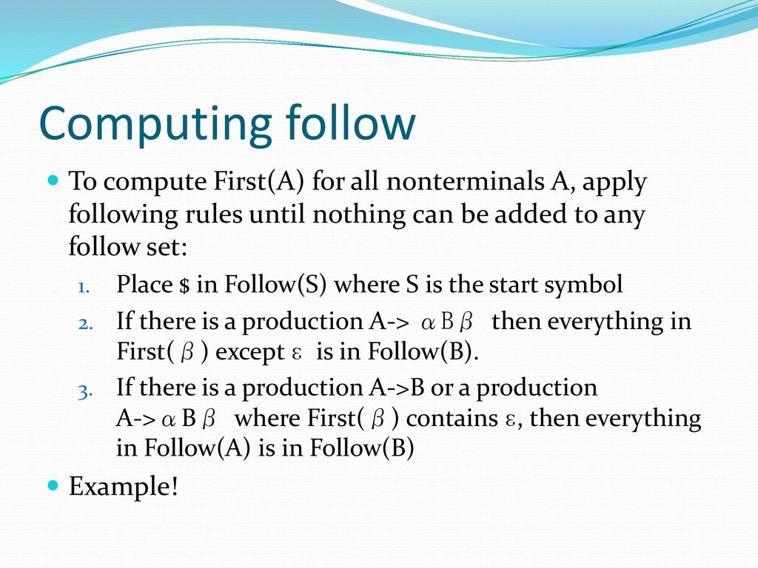
FOLLOW

Slide 46
To Compute FOLLOW()
FOLLOW(X) is the set of terminals that can appear immediately to the right of X in some derivation.
Rules for FOLLOW()
FOLLOW(S) always contains $ (end of input).
If a non-terminal A is followed by a terminal b in a production A → α b β, then b ∈ FOLLOW(A).
If a non-terminal A is followed by a non-terminal B, then FIRST(B) ⊆ FOLLOW(A) (except ε).
If ε ∈ FIRST(B), then FOLLOW(A) ⊆ FOLLOW(B).

Slide 47
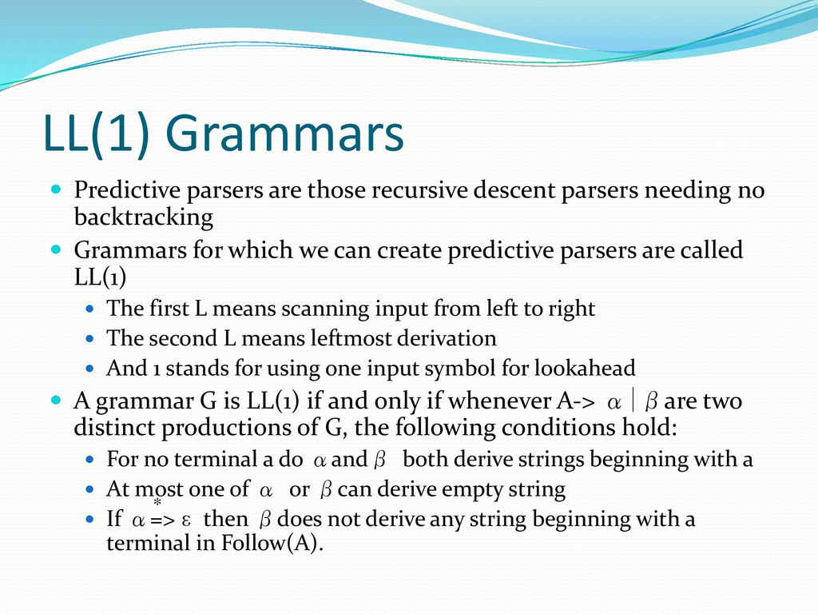

Slide 48
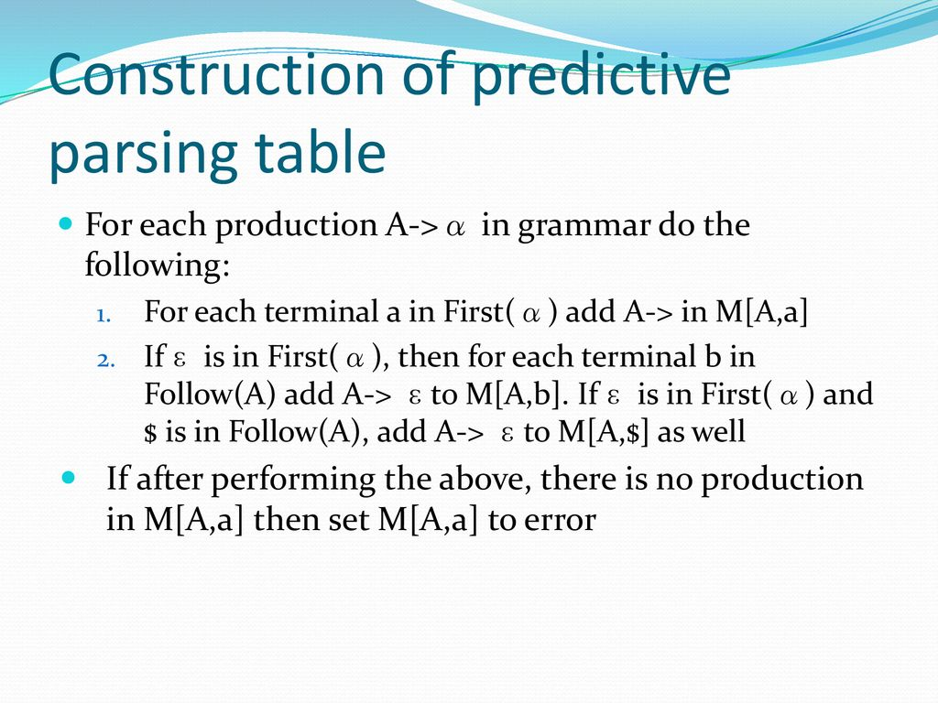

Slide 49
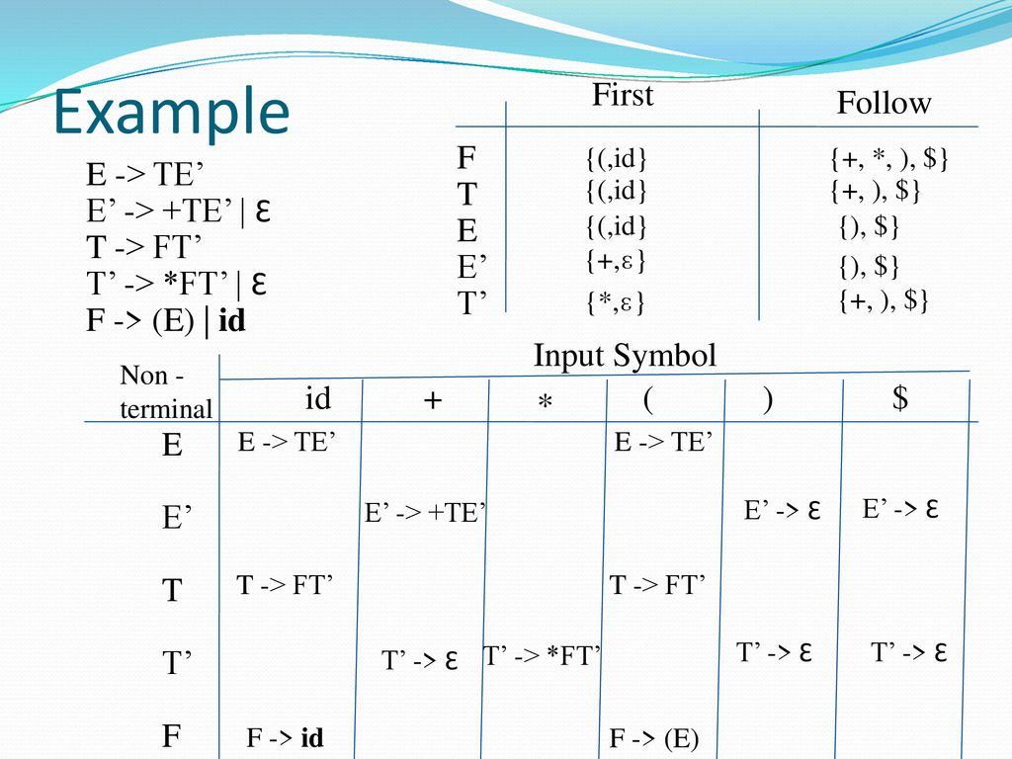

Slide 50
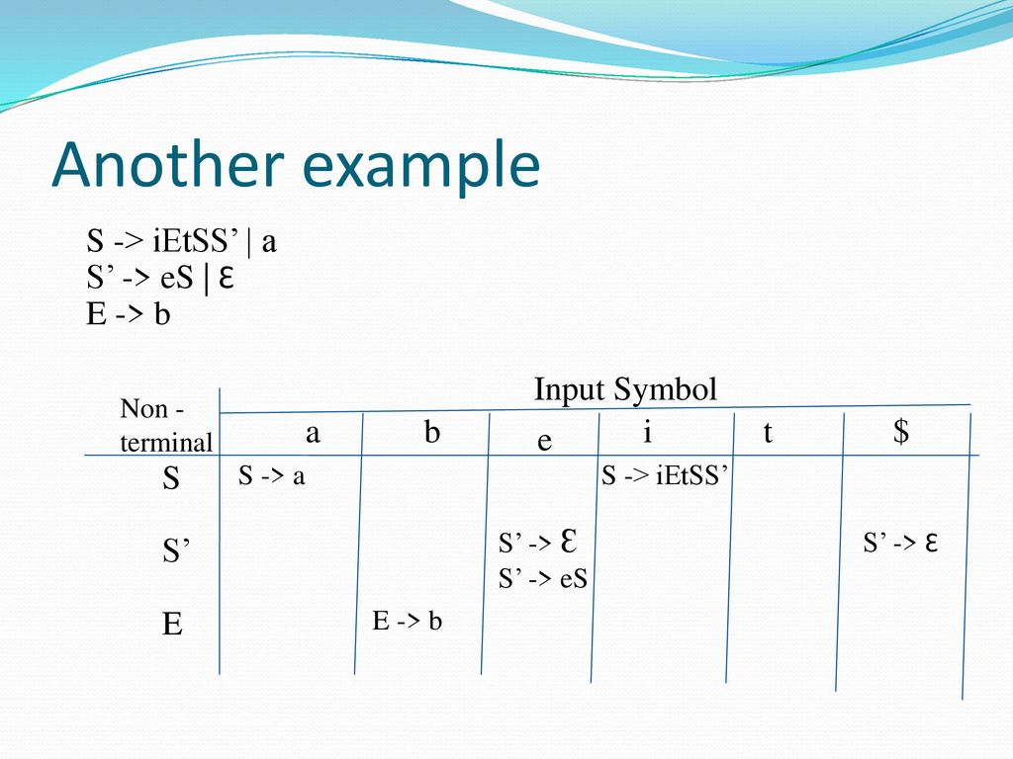

Slide 51
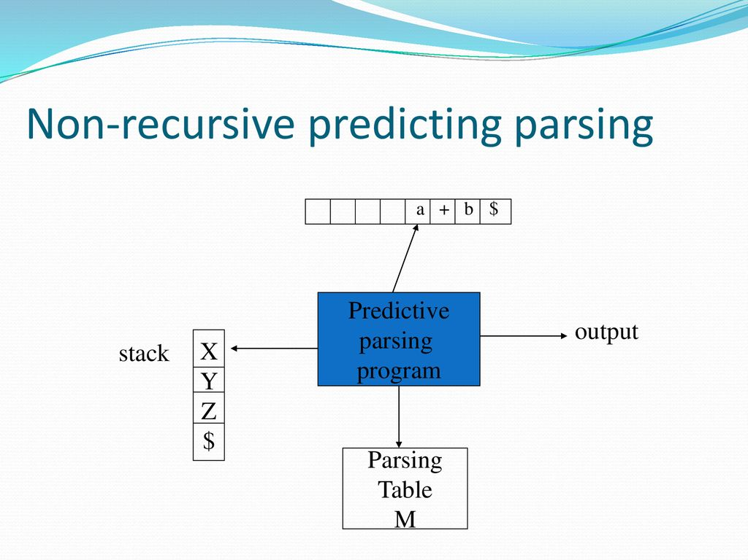

Slide 52
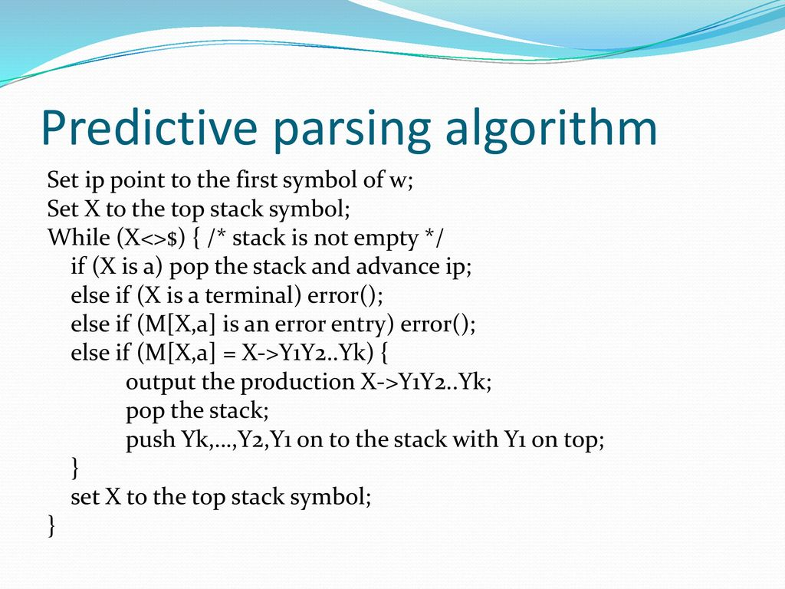

Slide 53
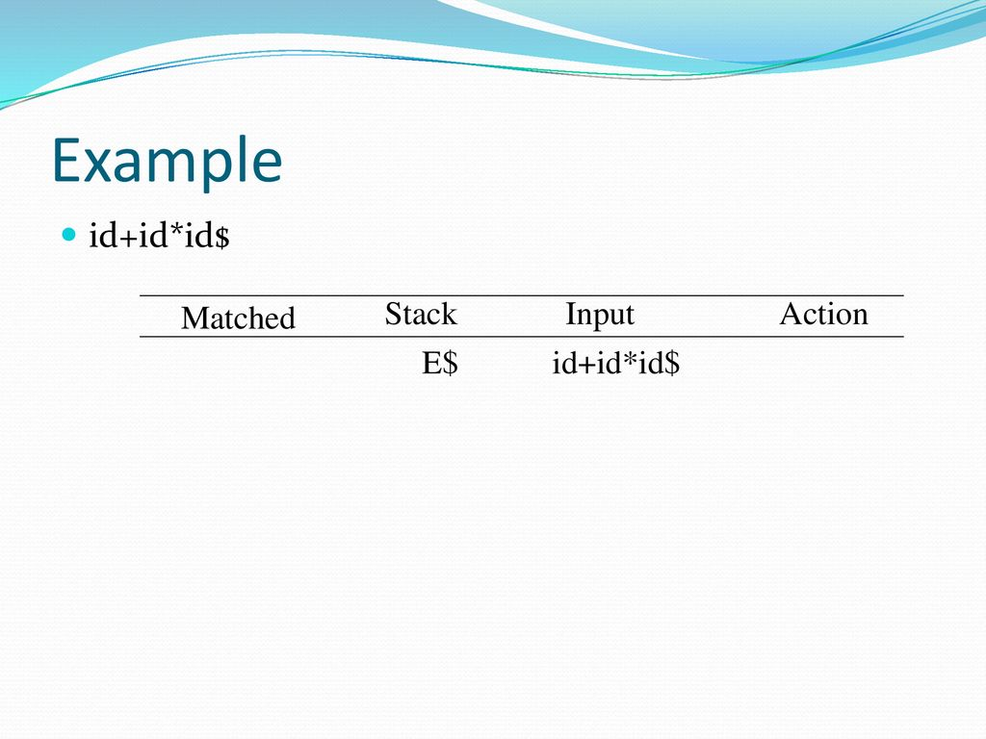

Slide 54
Error Recovery in Predictive Parsing
Panic Mode
Phrase-level Recovery
[For explanation refer notes]

Slide 55
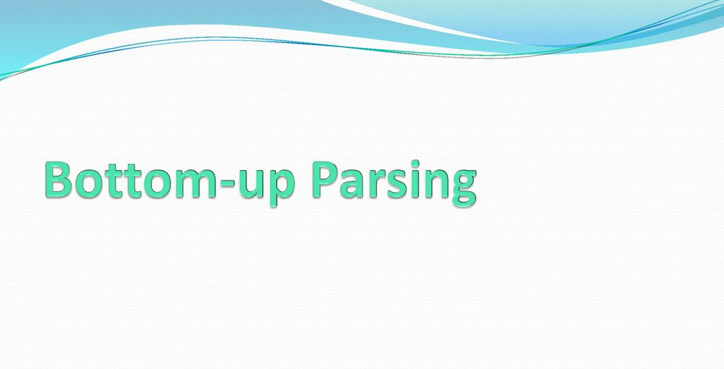

Slide 56
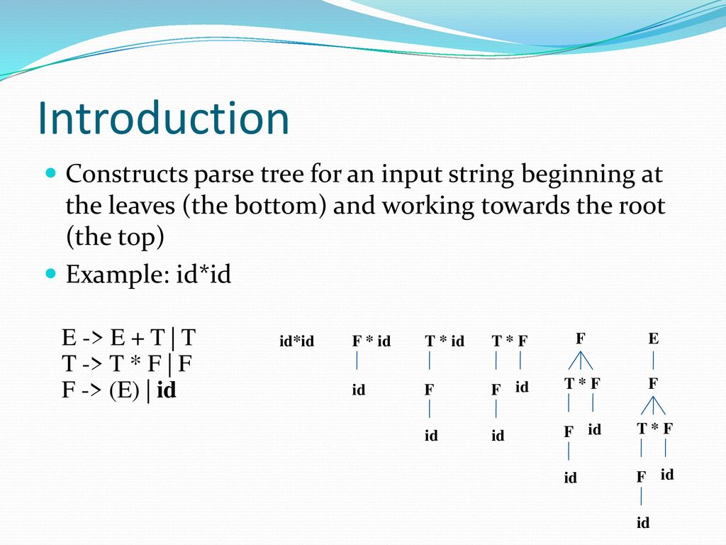

Slide 57
Reductions:
During bottom up parsing, the given string of terminals are reduced to the start symbol.
The process of searching for right hand side of production in a string consisting of terminals and non terminals and replacing it with corresponding left hand side of the production is called reduction.
The right most derivation to get the string id * id is:
E => T
=> T * F
=> T * id
=> F * id
=> id * id

Slide 58
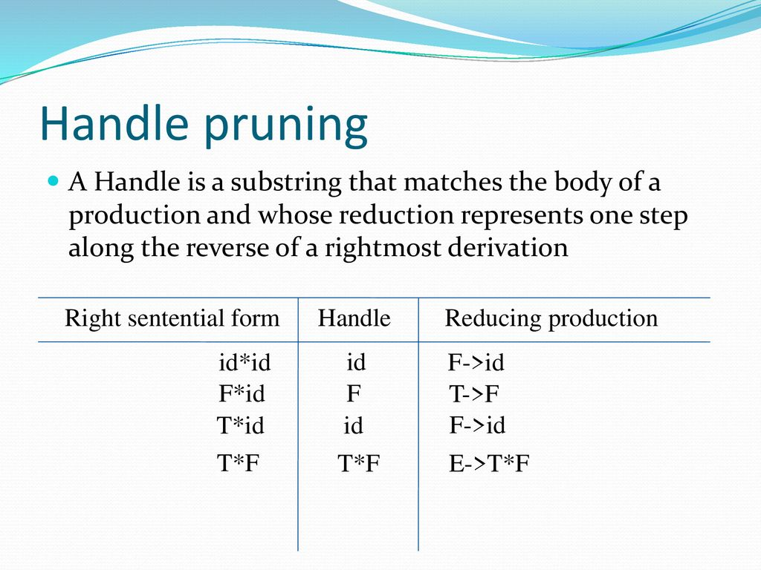

Slide 59
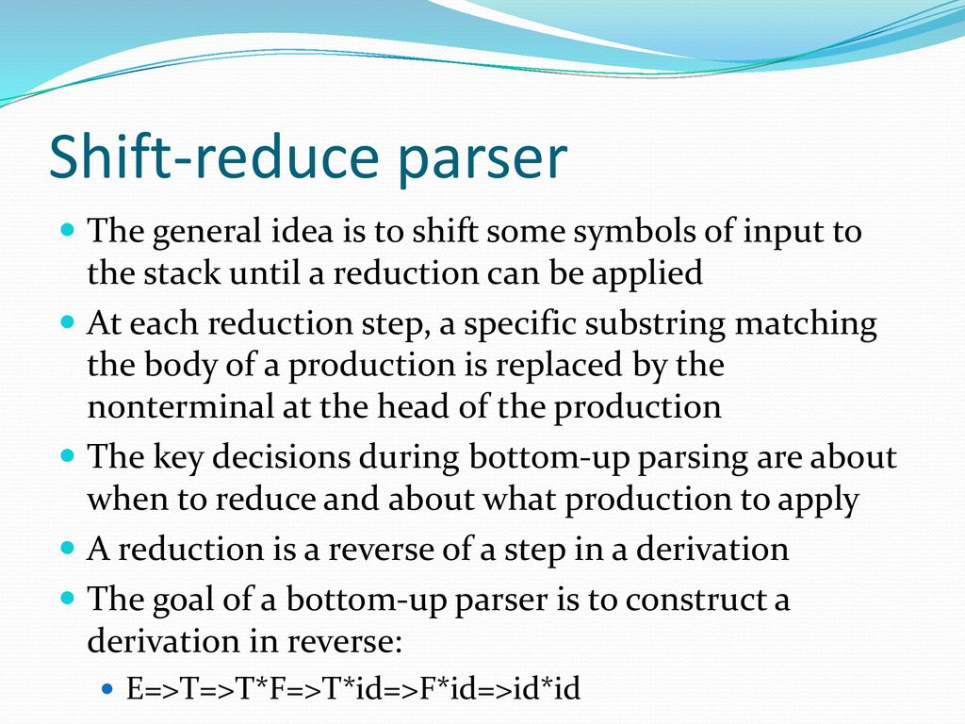

Slide 60
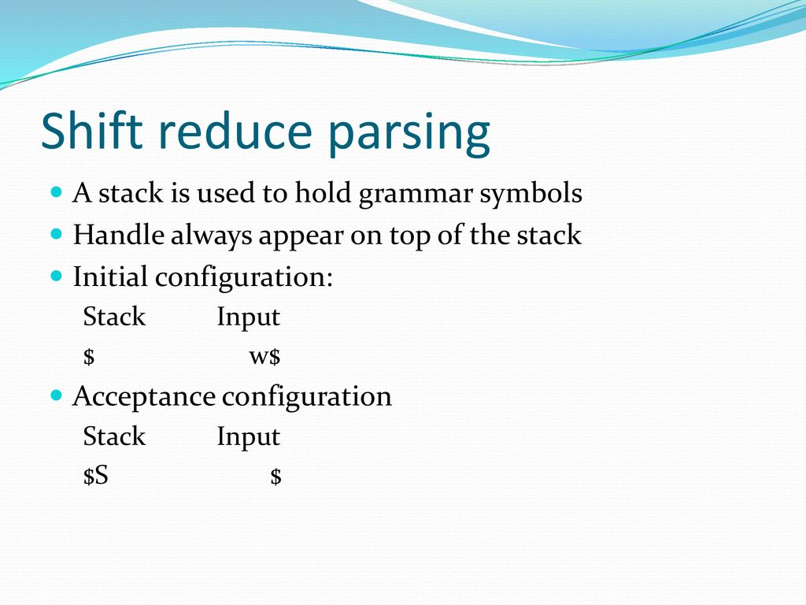

Slide 61
Shift-Reduce Parsing
The primary operations are shift and reduce, there are actually four possible actions a shift-reduce parser can make:
(1) shift, (2) reduce, (3) accept, and (4) error.
1. Shift: Shift the next input symbol onto the top of the stack.
2. Reduce: The right end of the string to be reduced must be at the top of the stack. Locate the left end of the string within the stack and decide with what nonterminal to replace the string.
3. Accept: Announce successful completion of parsing.
4. Error: Discover a syntax error and call an error recovery routine

Slide 62
Conflicts During Shift-Reduce Parsing
There are two types of conflicts.
Shift/reduce conflicts
Reduce/Reduce conflicts
Shift-Reduce Conflict: during parsing, by knowing the content of the stack and the next input symbol, if the parser cannot decide whether to shift the input symbol on to the stack or to reduce the angle on top of the stack, it results in shift-reduce conflict.
Reduce-Reduce Conflict: during parsing, F shift reduce parser finds a Ander on the top of the stack, the parser has to reduce the handle to the left hand side of the production. But, F2 or more productions have same handle on right hand side of the production, the parser cannot decide which production has to be selected for reducing. This conflict is called reduce-reduce conflict.

